Slide 1
Wellbeing and
reading

Slide 2
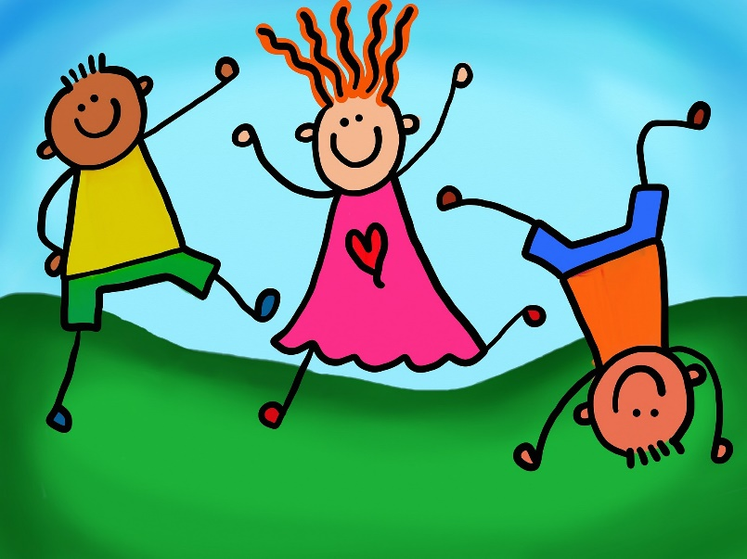
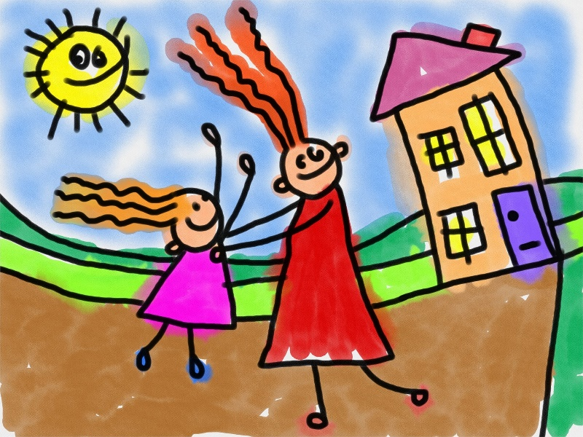
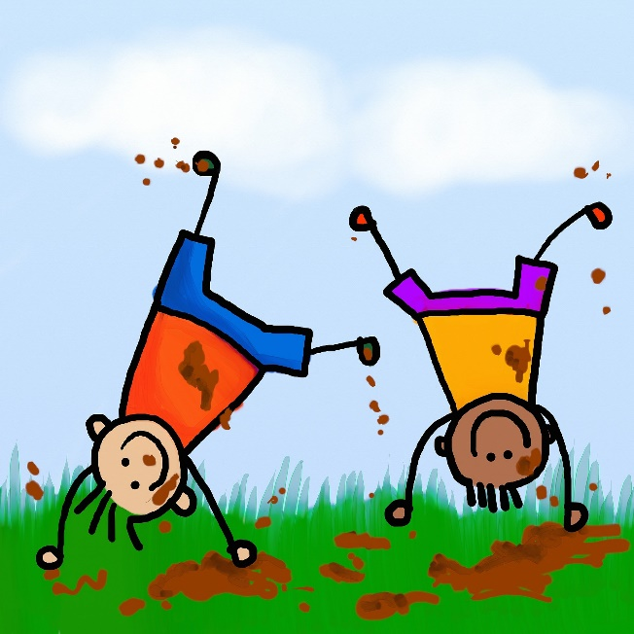
What do we mean by wellbeing?
“The state of being comfortable, healthy, or happy.”
Oxford Dictionary
1

Slide 3

What can stop us feeling happy?
Friendship problems
Family problems
School work
Loneliness
Grief
Feeling different
Fear
2

Slide 4
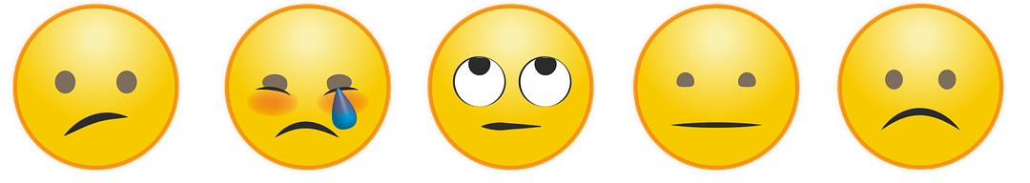
We all feel like this sometimes
3

Slide 5

What can we do to help ourselves?
One of the really easy ways you can look after yourself if you're worried is...
READING !
4

Slide 6
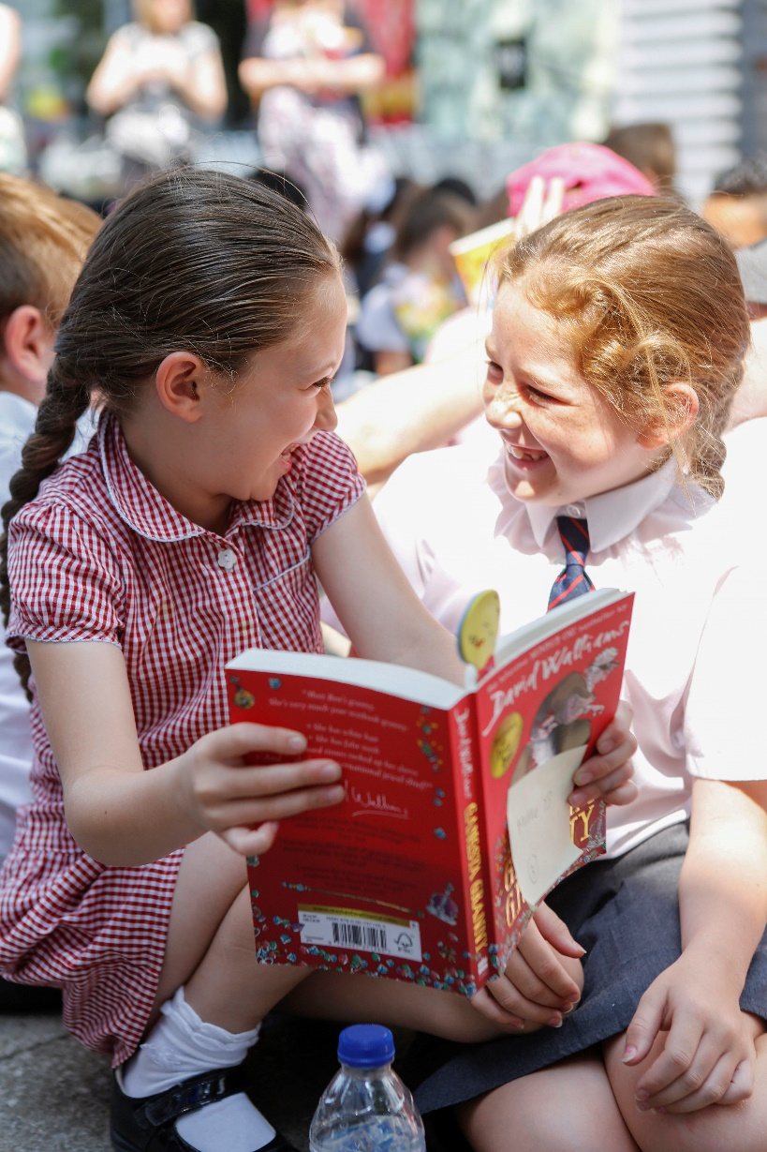
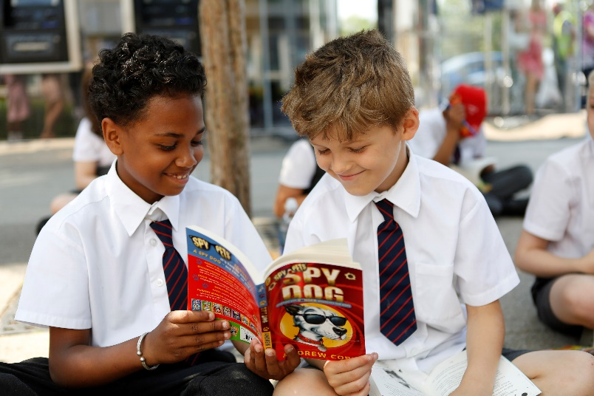
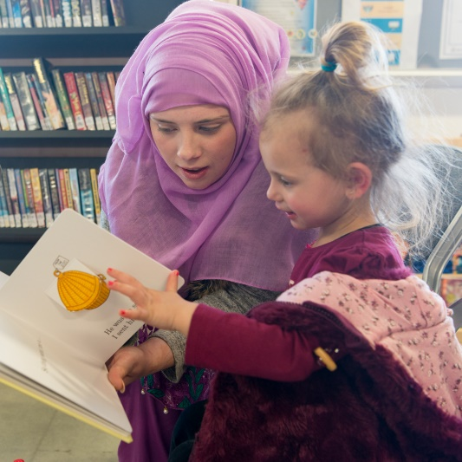
How can reading for enjoyment help?
Reading for enjoyment can:
Help you feel you are not alone
Help you find out about things that are difficult to talk about
Help you understand things you are not sure about
5

Slide 7

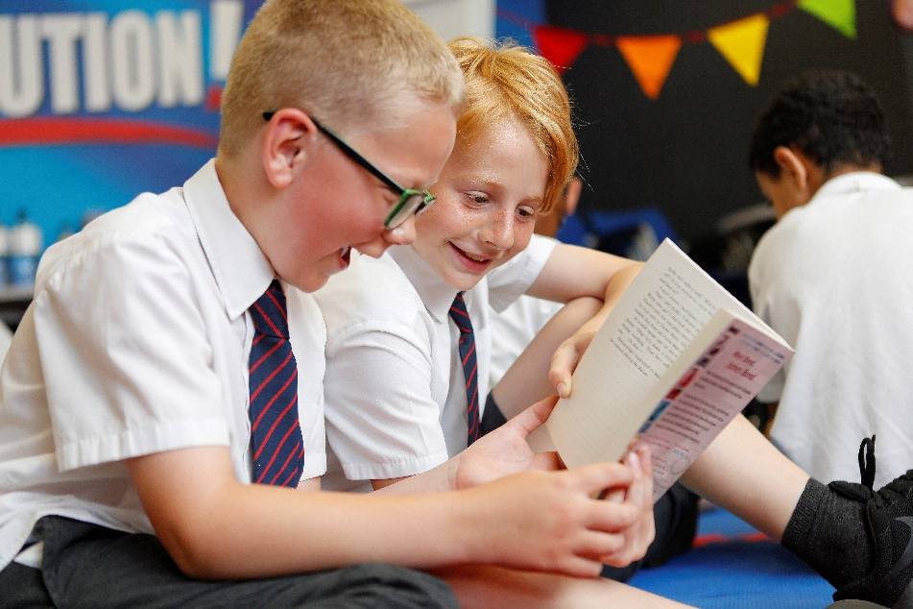
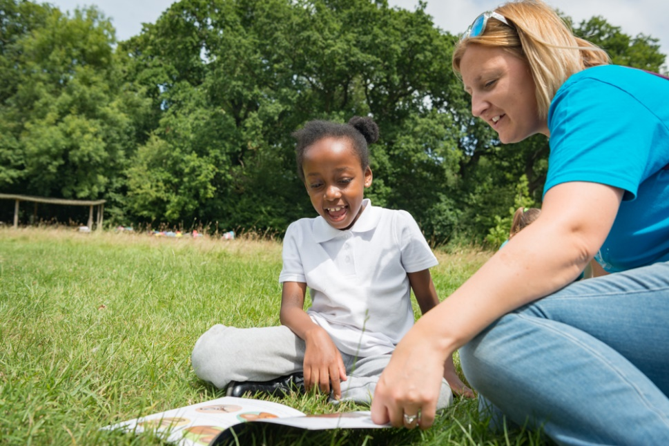
How can reading for enjoyment help?
Reading for enjoyment can:
Help you share things with others
Help you relax
Make you smile!
6

Slide 8
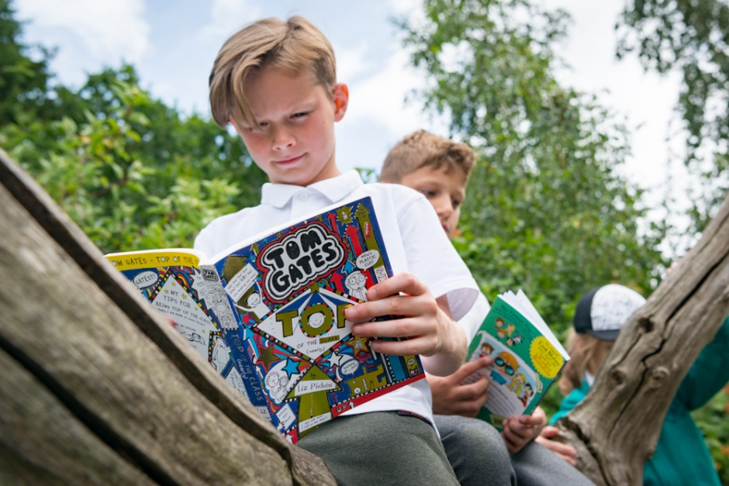
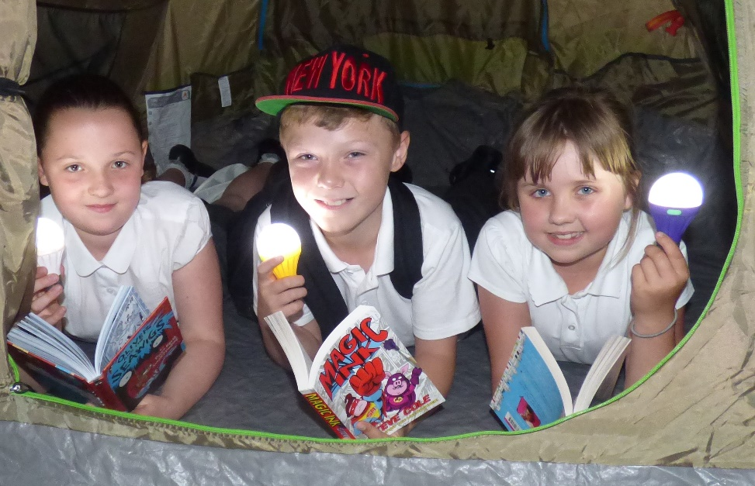
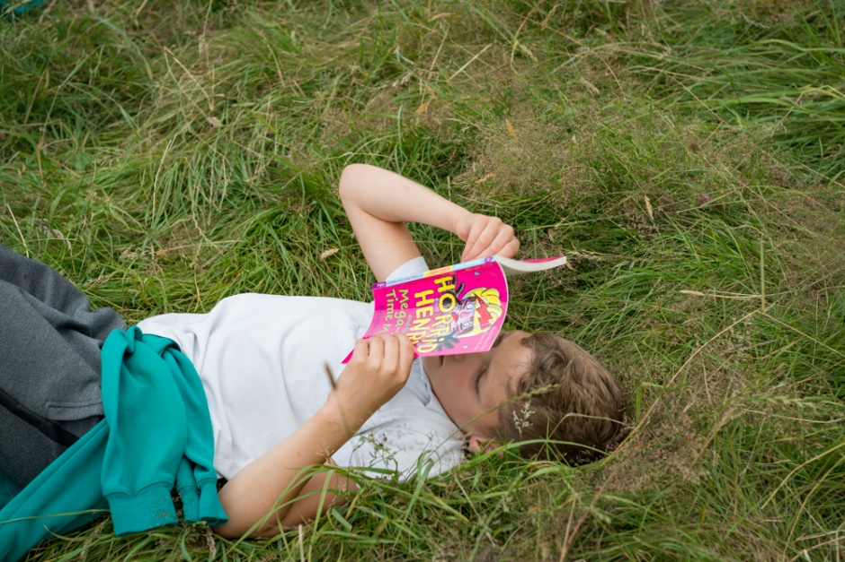
Read everything and everywhere!
Read whatever you enjoy – chapter books, graphic novels, comics, poetry and short stories.
Read aloud or listen to an audio book – if you can’t read well, ask someone to read aloud to you.
Talk about books with your friends and family and celebrate what you’ve read.
8

Slide 9


