Slide 1

Isle of Wight 2026
Monday 29th June- Friday 3rd July
Residential Trip Information
8 Hill Street Hotel
Achievement for all in a community that cares

Slide 2

Key Information
Adults
Mr Coker
Mrs Priest
Mrs Cook
Mr Figg & 2 Meadgate staff.
Achievement for all in a community that cares

Slide 3
What Do I Take?
Towels
Waterproof jacket
Water bottle
T- shirts
Jeans/casual trousers
Shorts
Warm sweatshirts/ jumpers
Underwear & socks
Nightclothes, slippers
Trainers/Shoes for beach
Sun hat
Plastic bag for dirty washing
Back pack for day trips
Toiletries
Suntan lotion
Soft toy!
Books & magazines
Card games
Camera
Pocket Money X 5 days or Revolut Card
Lunch (for coach)
Travel sickness tablets (all medication to be given to child’s group leader)

Slide 4
Do Not Take...
Precious items
Jewellery
Mobile Phones
Devices with communication capacity
Air Tags
Hair driers/straighteners
Food (apart from lunch for Day One)
Fizzy Drinks

Slide 5
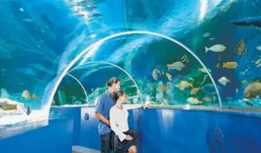

Departure Day- Monday 29th June 2026
8 o’clock Arrive at School
Bring Money/ Meds to your Group Leader
We will check you have a packed lunch and
water bottle too.
8.30am Depart from School
9 o’clock Depart from Meadgate 9.20am
10.30am Comfort Break at Cobham Services
12.30pm Portsmouth Blue Reef Aquarium & Lunch
4.40pm Ferry - Portsmouth to Fishbourne
6 o’clock Arrive at 8 Hill Street Hotel
Settle In Rooms
Safety Talk
Evening Meal
Beach

Slide 6


Tuesday 30th June
8 o’clock Breakfast
10 o’clock Depart Hotel
11.15 Osborne House in East Cowes
Lunch On Site
2.30 Wildheart Sanctuary in Sandown for Tour & Talk
6 o’clock Dinner
Evening- Beach
Achievement for all in a community that cares

Slide 7

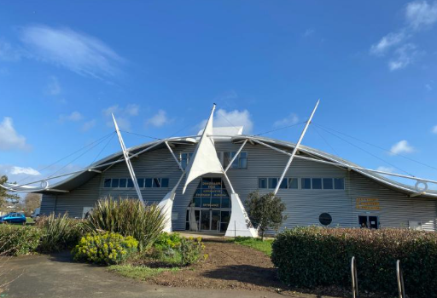
Wednesday 1st July
8 o’clock Breakfast
10 o’clock Blackgang Chine Theme Park
Lunch On Site
2.30 Dino Isle in Sandown for Talk, Museum Visit & Fossil Hunt
6 o’clock Dinner
Evening- Beach
Achievement for all in a community that cares

Slide 8

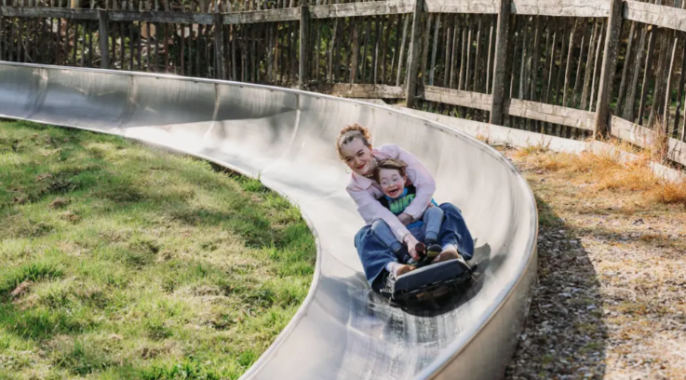
Thursday 2nd July
8 o’clock Breakfast
10 o’clock Shanklin Chine Waterfall
11 o’clock Robin Hill
One ride on the toboggan per child
Lunch on Site
6 o’clock Dinner
Evening- Beach or Disco
Achievement for all in a community that cares

Slide 9
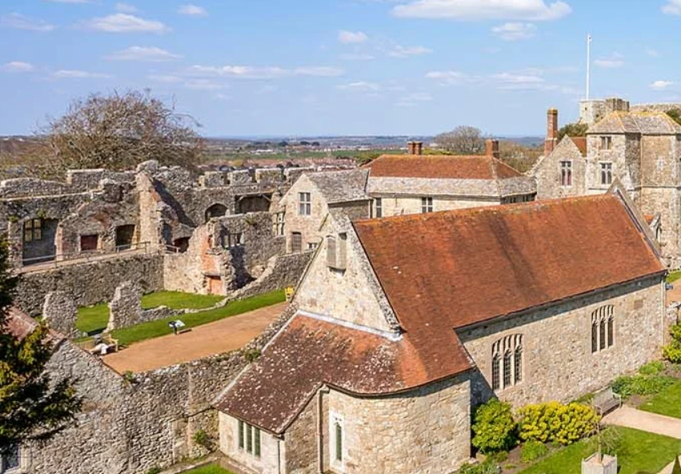

Friday 3rd July
9 o’clock Depart Hotel
10 o’clock- 1.15 Carisbrooke Castle
Early Lunch
2 o’clock Ryde Superbowl including food
3.40pm. – Wight Link Ferry
7.30-8.30pm Estimated time of arrival back at school
Subject to traffic. Text messages will keep you informed.
Achievement for all in a community that cares

Slide 10

FOOD
Sausage Sandwich
Egg on Toast
Beans on Toast
Toast with Jam/Butter
Croissant with Jam
Cereals
Choices are made by the pupils the evening before.
Achievement for all in a community that cares

Slide 11

FOOD- PACK LUNCH
Sandwich: Cheese, Ham, or Strawberry Jam
Crisps
Biscuits
Fruit
Water
Achievement for all in a community that cares

Slide 12

FOOD- DINNER
Monday- Sausage, Mash & Peas
Tuesday- Nuggets, Chips & Beans
Wednesday- Roast Chicken
Thursday- Beef Burger & Chips
Vegetarian options available each day.
Puddings include ice cream, cake,
doughnuts & lollies!

Slide 13
DAY GROUPS
Mrs Priest | Mr Coker | Mrs Cook
The class will remain together through the vast majority of activities- this is mostly for speed of head count and ensuring safety.

Slide 14
Other Important Information
Permission forms. Important details – things we need to know.
Info transferred to the hotel regarding any specific needs.
Arrival at the hotel- safety talk and fire drill practice.
Hotel behaviour briefing.
Walking with partners/ routines / headcounts.
Support and contact ongoing from our providers at the Isle of Wight Experience.
Allergies- Please inform us of any changes.
Talk to us about anything- putting it in an email really helps me!
Achievement for all in a community that cares

Slide 15

Any Questions?

